Slide 1

Web Service and Ruby on Rails
WEBD 5201 WEB DEVELOPMENT
RAMKUMAR VELMURUGAN

Slide 2
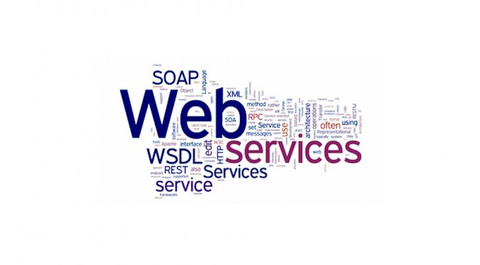
Web Service
A web service is a software system that supports interoperable machine-to-machine communication over a network.
Web services are a key component of service-oriented architectures (SOA) and are commonly used for various purposes, including data exchange, business logic implementation, and integration between heterogeneous systems.

Slide 3
Key characteristics of web services
Interoperability
Loose Coupling
Discoverability
Statelessness
Standardized Protocols

Slide 4
History
1999 – SOAP (Simple Object Access Protocol)
2000 - WSDL (Web Services Description Language
2000s - REST (Representational State Transfer)
2007 - Introduction of JSON (JavaScript Object Notation)
2010s – Microservices
2015 - GraphQL

Slide 5
SOAP vs REST
 | SOAP | REST
Message format | XML | JSON/XML
Security | High | Low
Performance | Low | High
Complex operation | Suitable | Not Suitable
Use cases | Enterprise | Light weight and Public API’s

Slide 6
Restful Web Services
GET
POST
PUT
PATCH
DELETE

Slide 7
Example
Use a GET request to retrieve tasks: GET http://localhost:5000/tasks
Use a GET request to retrieve a specific task: GET http://localhost:5000/tasks/1
Use a POST request to create a new task: POST http://localhost:5000/tasks
Include a JSON request body with the task data.
Use a PUT request to update an existing task: PUT http://localhost:5000/tasks/1
Include a JSON request body with the updated task data.
Use a DELETE request to delete a task: DELETE http://localhost:5000/tasks/1

Slide 8


Tools
POSTMAN
SOAP UI
Swagger UI
JMeter

Slide 9
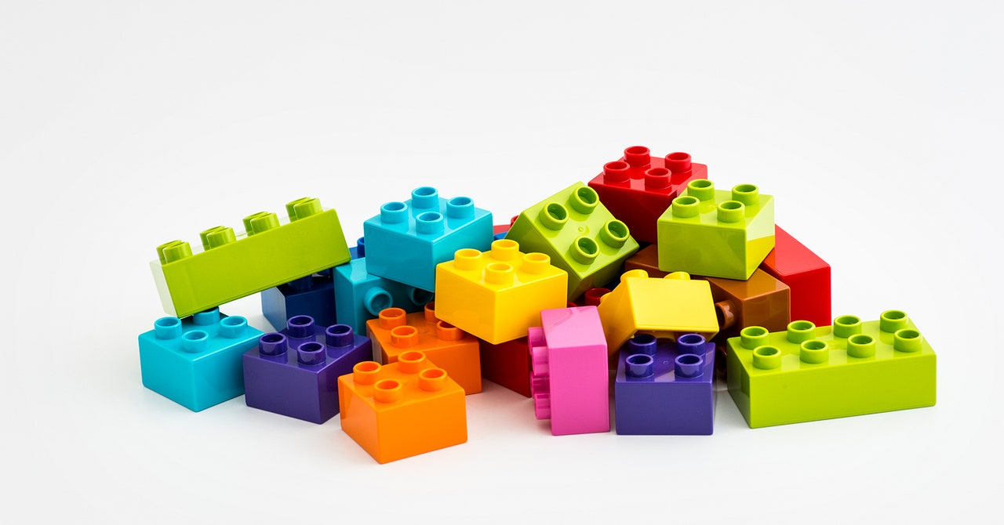
Activity
Install postman tool on your machine
https://jsonplaceholder.typicode.com/users

Slide 10

Ruby on Rails
Ruby on Rails is an open-source web application development framework
Used for simple projects to complex projects.
Follows MVC architectural design pattern

Slide 11
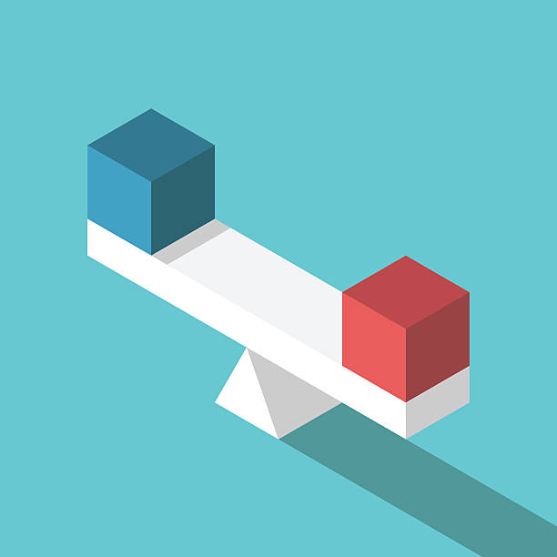
PHP Laravel vs Ruby on Rails
 | PHP - Laravel | Ruby on Rails
Framework | Only for Web Development | Full Stack Web Development
Use cases | Small website | Small website to Enterprise Apps
Template Engine | Blade | ERB
Database Integration | Eloquent ORM | Active Record
CLI Tool | Artisan | Rails CLI

Slide 12
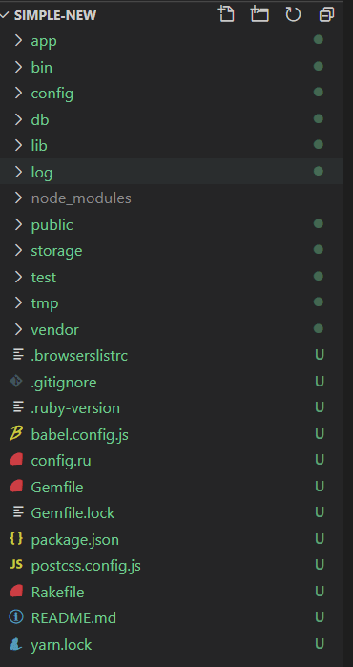
Folder Structure
App – Core of Ruby on Rails
Bin – Executables
Config – Config files
Db – database schema
Lib – Libraries
Gemfile – Dependency management

Slide 13
Ruby on Rails Controller
'rails generate controller ControllerName’
Controller file created under the app/controller
The controller will support all the HTTP verbs
Request handling is available inside the ‘config/routes.rb’
Views are located ‘app/view/controller_name’

Slide 14
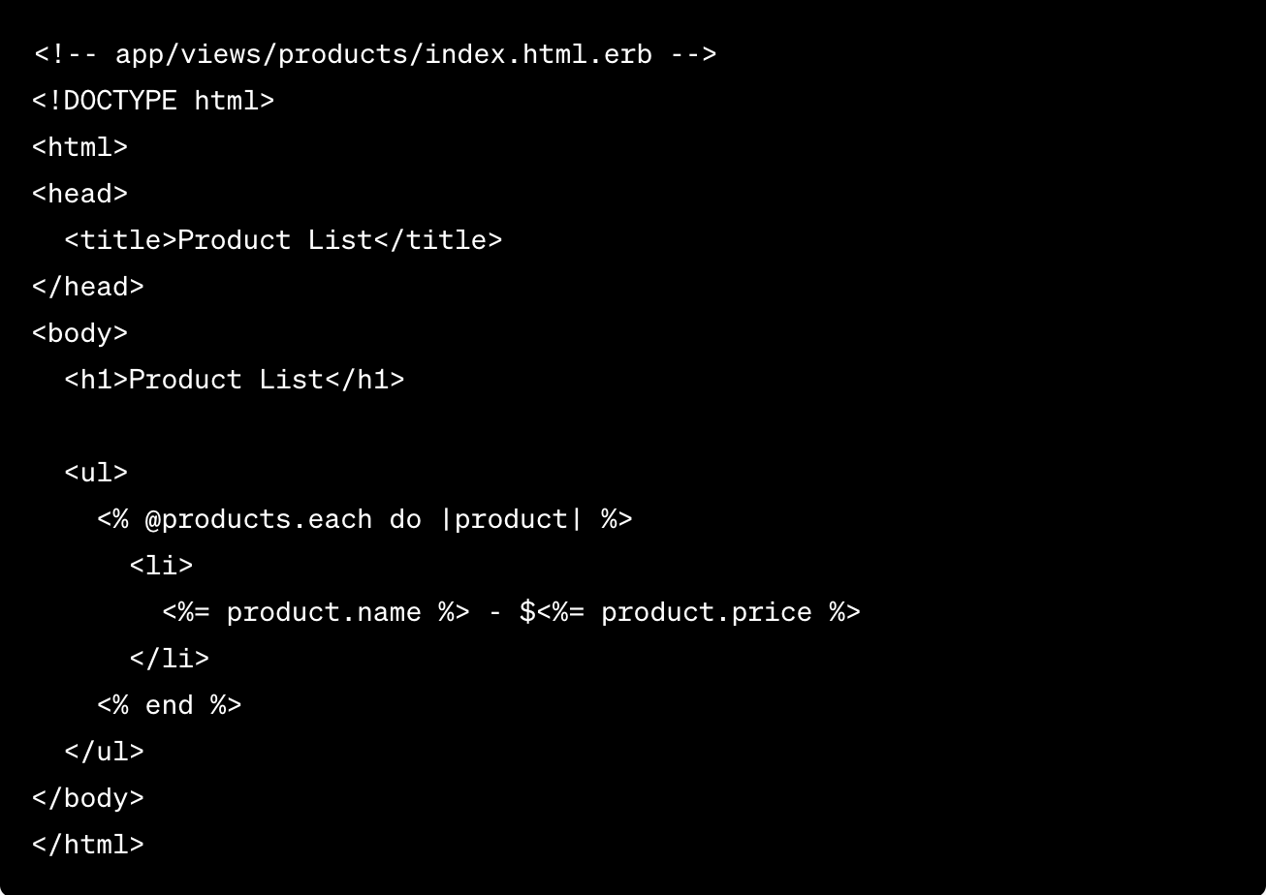
Embedded Ruby ERB
Default templating Engine provided by Ruby
Ruby code inside the HTML templates
<% %> , <%= %>, @products – instance variable for the controller

Slide 15
Active Record
Allows you to interact with your database using ruby objects methods.
‘rails generate model’ Book title:string author:string published_date:date
’rails db:migrate’
Model -> app/model/book.rb

Slide 16
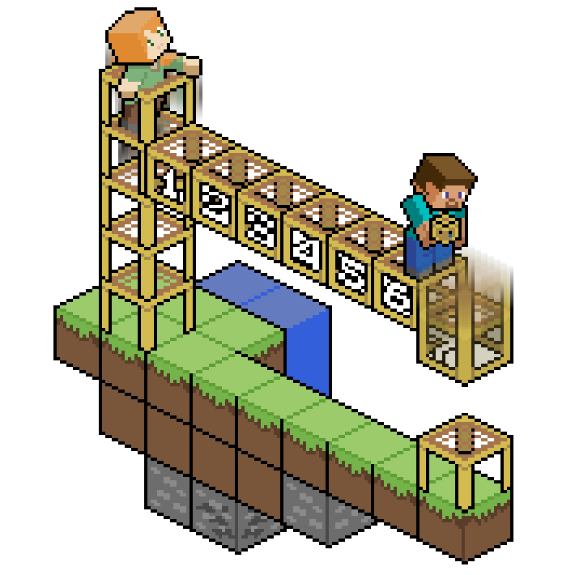
Scaffold
The scaffold generator is a powerful tool for quickly generating a set of resources for your application, including the model, views, controller, and routes.
Once you've generated the scaffold, you can run rails db:migrate to apply the database changes, and you'll have a fully functional CRUD interface for managing products.

Slide 17
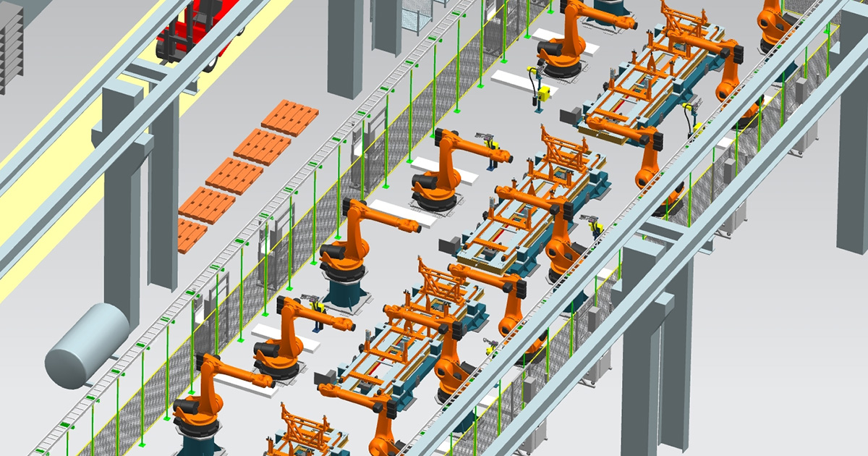
ACTIVITY 2
https://github.com/spkdroid/RubyRails-Tutorial
Install the Rails server and create the first index page

Slide 18
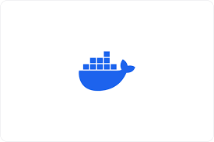
DOCKER
Docker is a platform that enables developers to automate applications' deployment, scaling, and management within lightweight, portable containers.
Docker uses containers and isolated environments that encapsulate applications and their dependencies. Containers are more lightweight and efficient than traditional virtual machines.

Slide 19
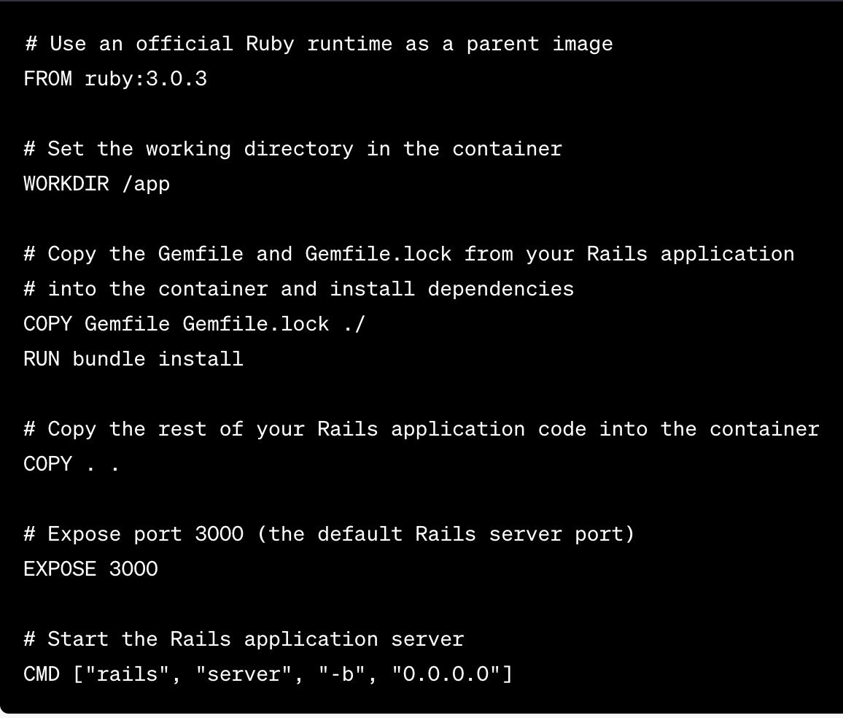
Dockerfile
A Dockerfile is a plain text configuration file used to define the specifications and instructions for building a Docker image. Docker images are read-only templates that contain the application code, runtime, libraries, and other dependencies required to run an application within a Docker container.

Slide 20
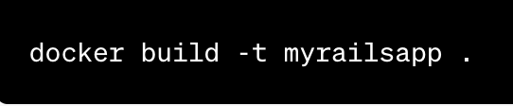

Build a Docker Image

Slide 21
Activity 3
https://github.com/spkdroid/RubyRails-Tutorial
Building a RESTful Web Service with Ruby on Rails

